Slide 1
Lessons and Action：
What We Learned from 10K SSD-Related Storage System Failures
Erci Xu,Mai Zheng,Feng Qin,Yikangxu,Jiesheng Wu
我们毕业啦
其实是答辩的标题地方
李文铖

Slide 2
研究背景
问题概述
System Architecture & Dataset
RASR Failures Overview
教训与启示
总结思考
Lessons & Actions
Conclusions

Slide 3

研究背景

Slide 4



SSD-based Storage System Powers The Life Essentials

Slide 5
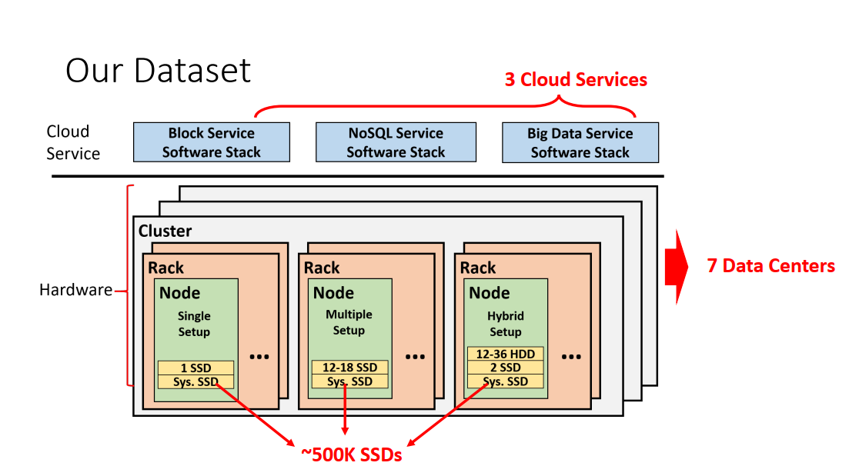

Slide 6
问题概述

Slide 7
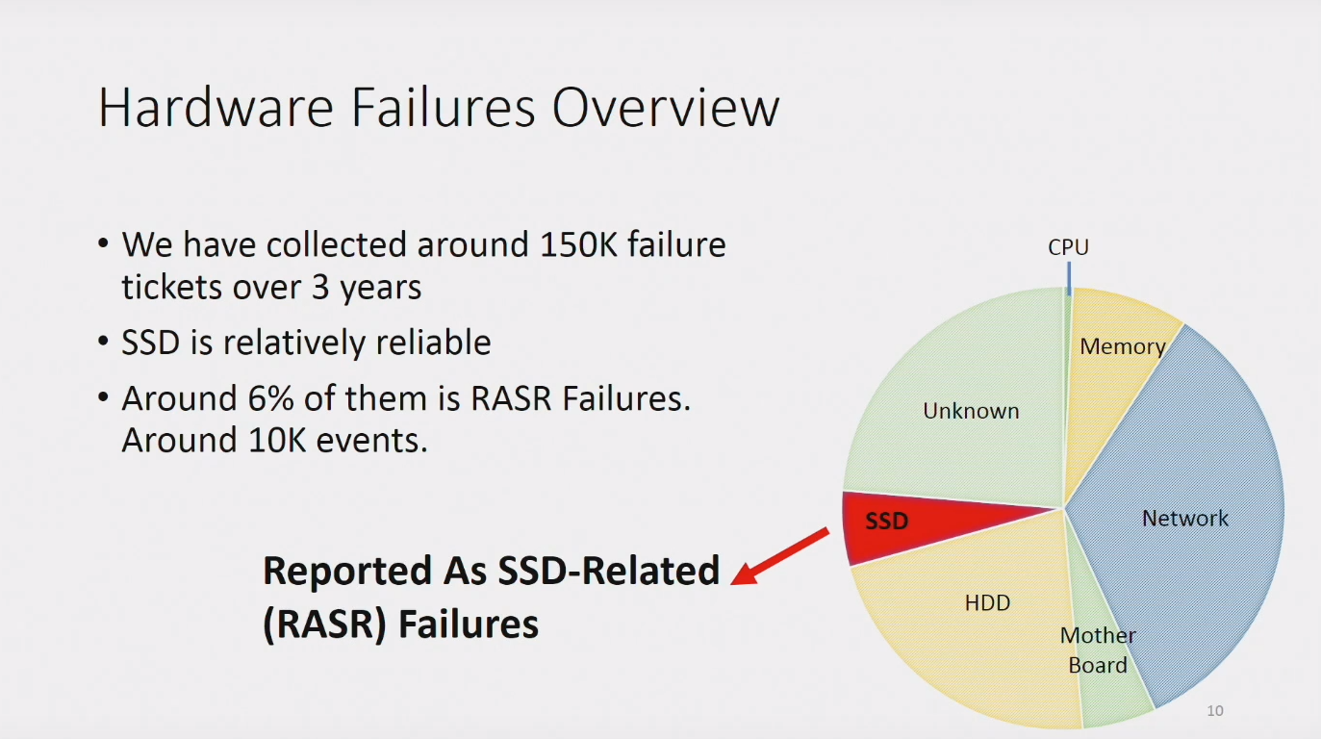

Slide 8
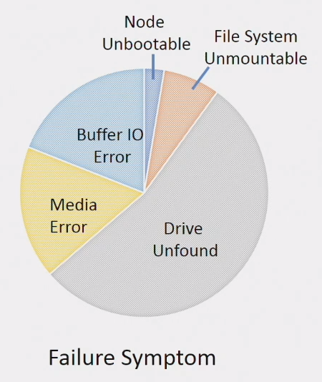
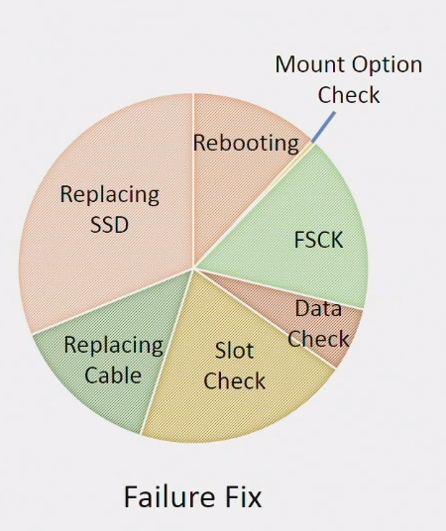
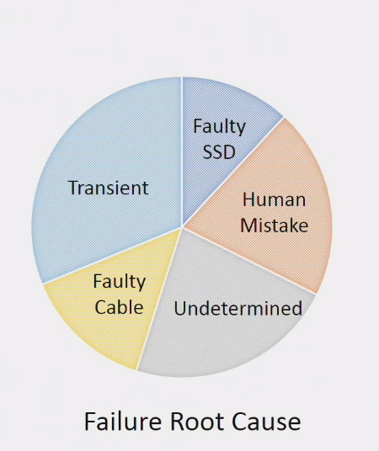
RASR Failures Overview

Slide 9
教训与启示

Slide 10
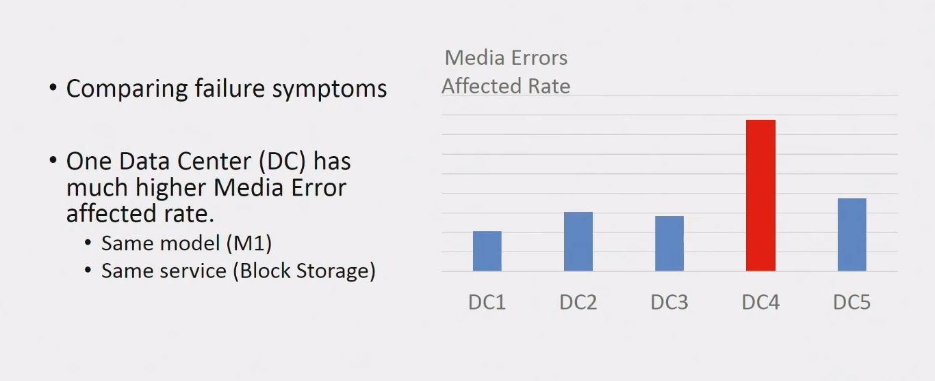
L&A for Hardware Architects

Slide 11
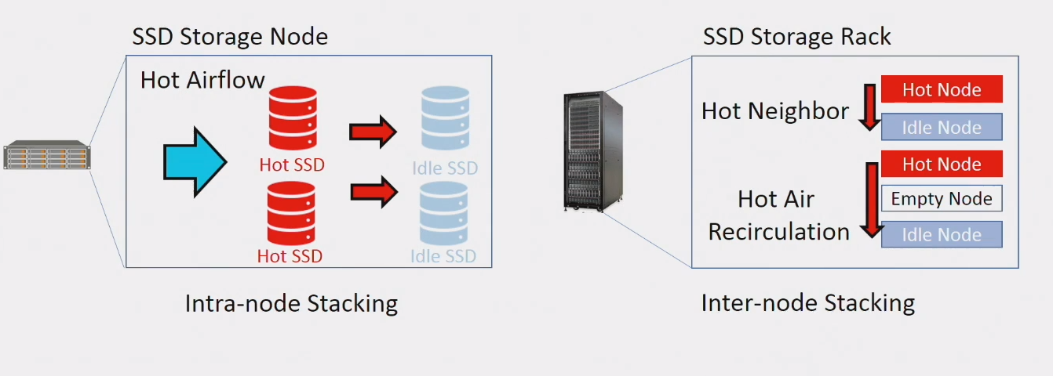
L&A for Hardware Architects
Passive Heating:Heating on idle SSDs by neighboring active devices

Slide 12
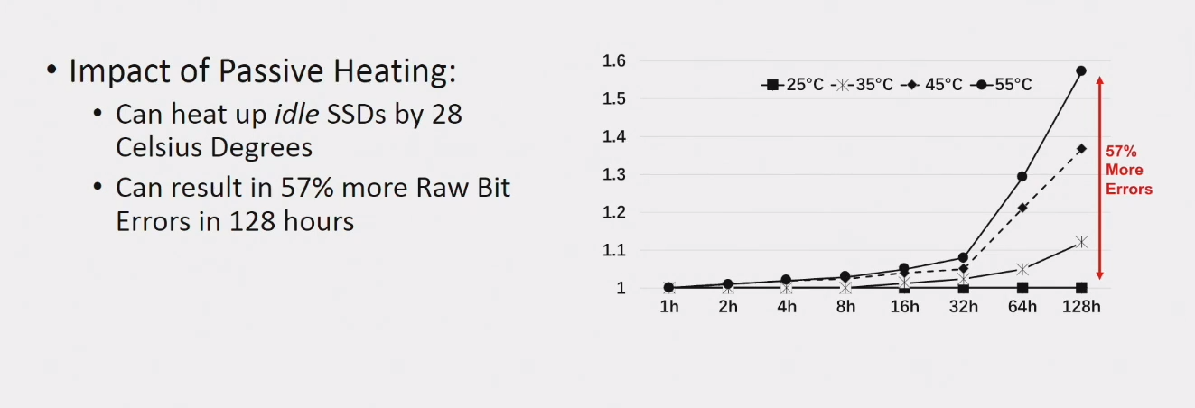
L&A for Hardware Architects

Slide 13
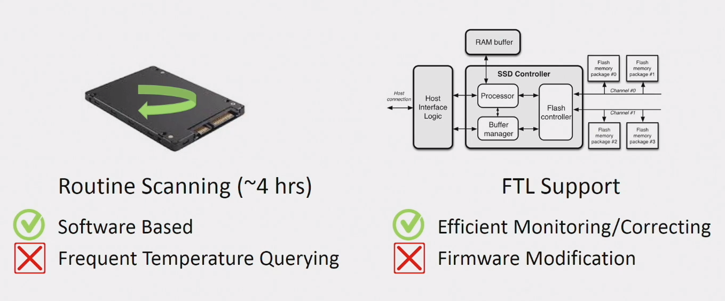
L&A for Hardware Architects

Slide 14
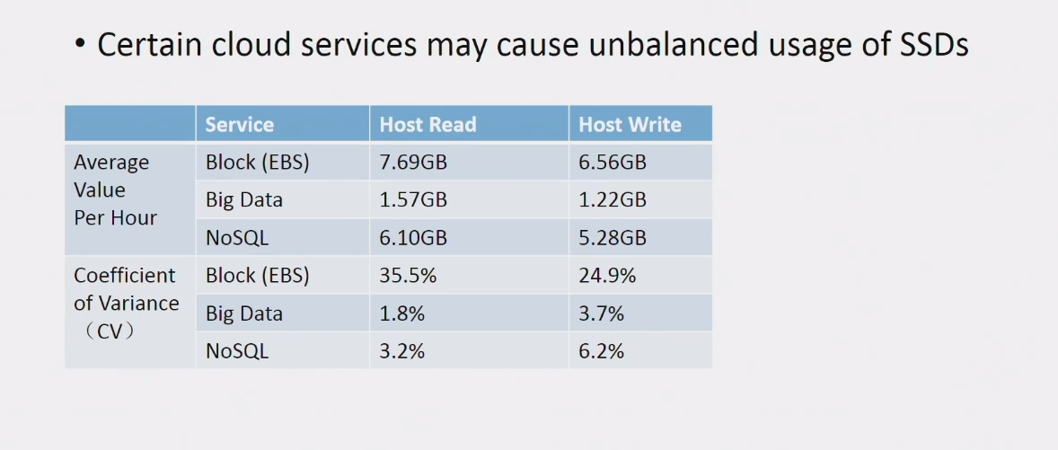
L&A for Software Developers

Slide 15
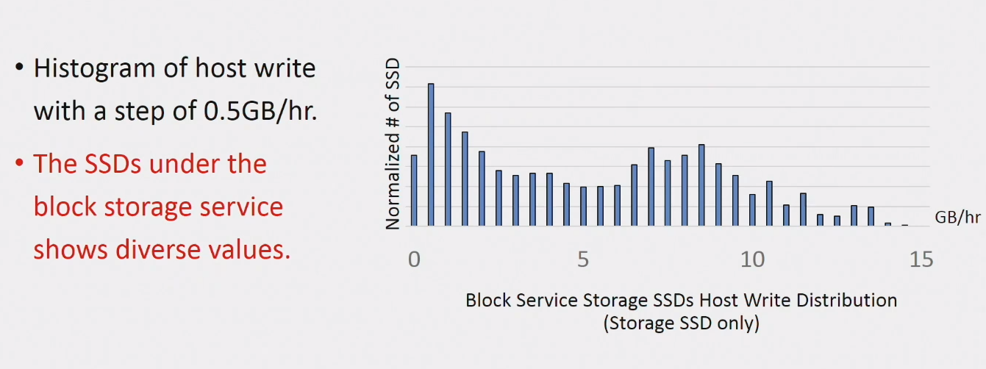
L&A for Software Developers

Slide 16
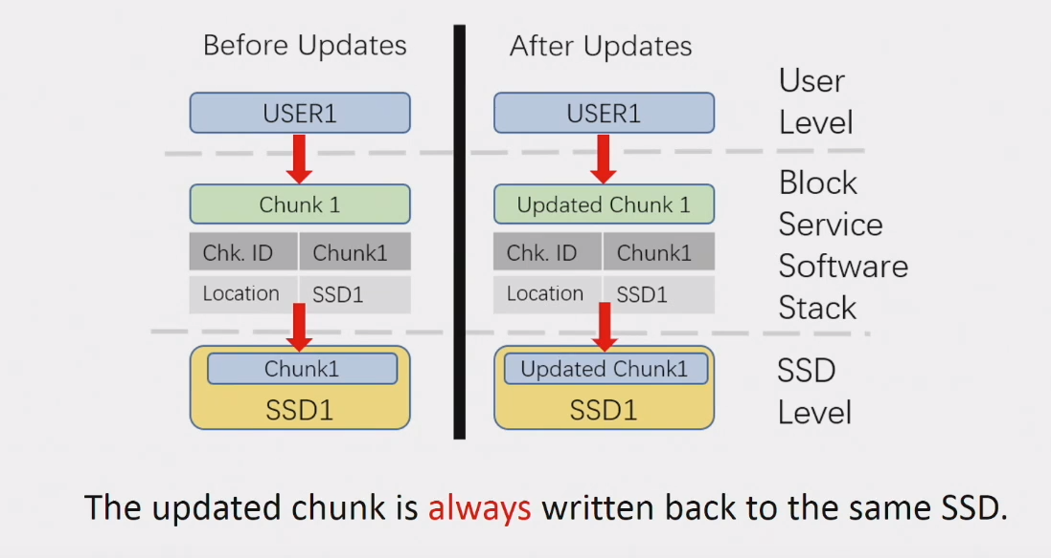
L&A for Software Developers

Slide 17
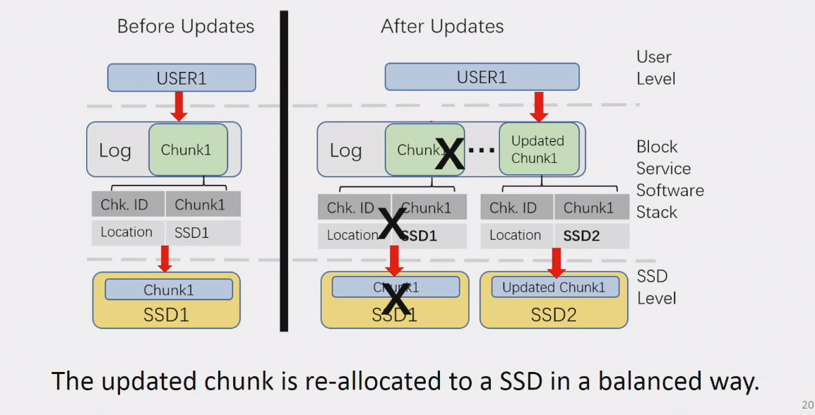
L&A for Software Developers

Slide 18
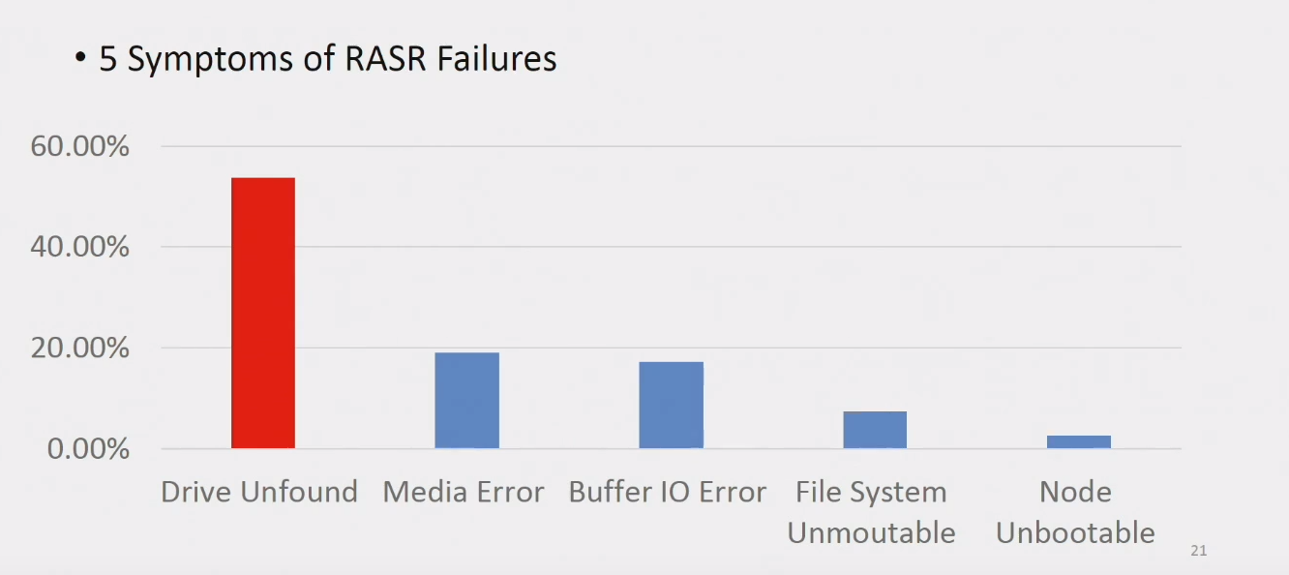
L&A for System Administrator:Part I

Slide 19
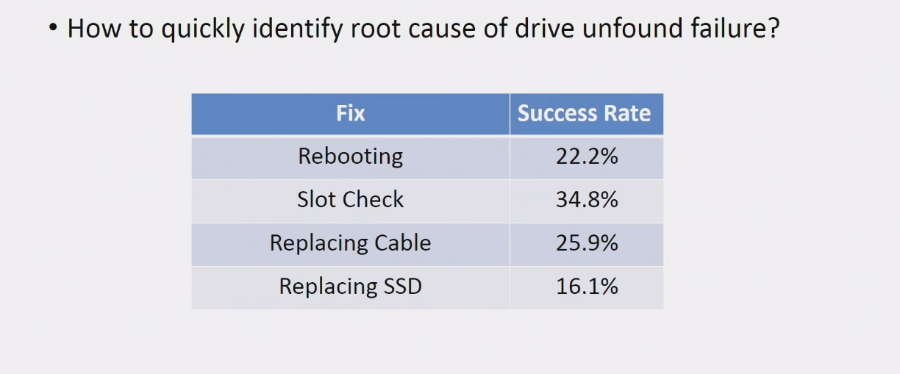
L&A for System Administrator:Part I

Slide 20
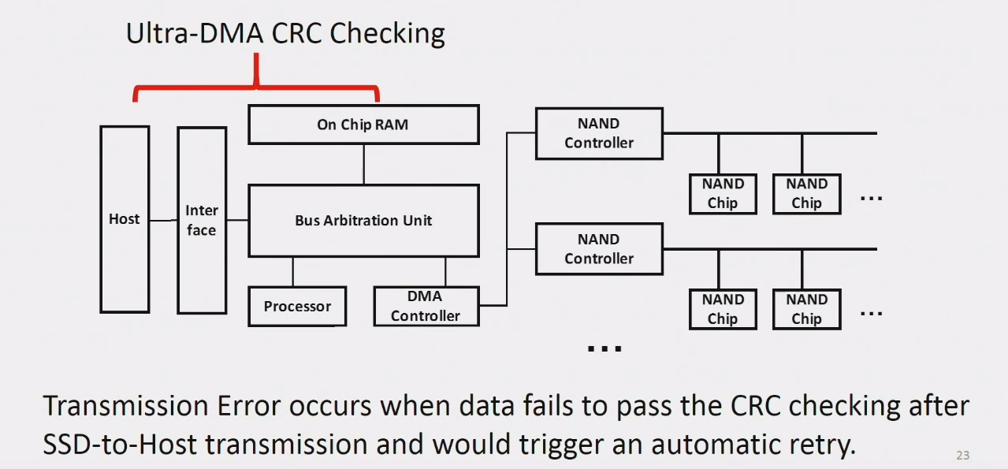
L&A for System Administrator:Part I

Slide 21
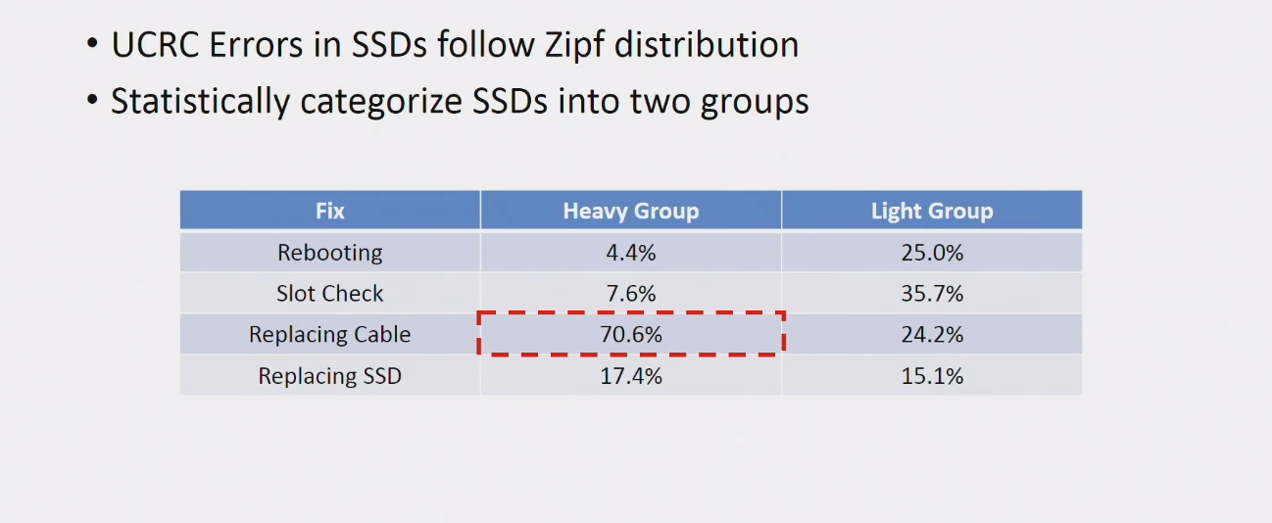
L&A for System Administrator:Part I

Slide 22
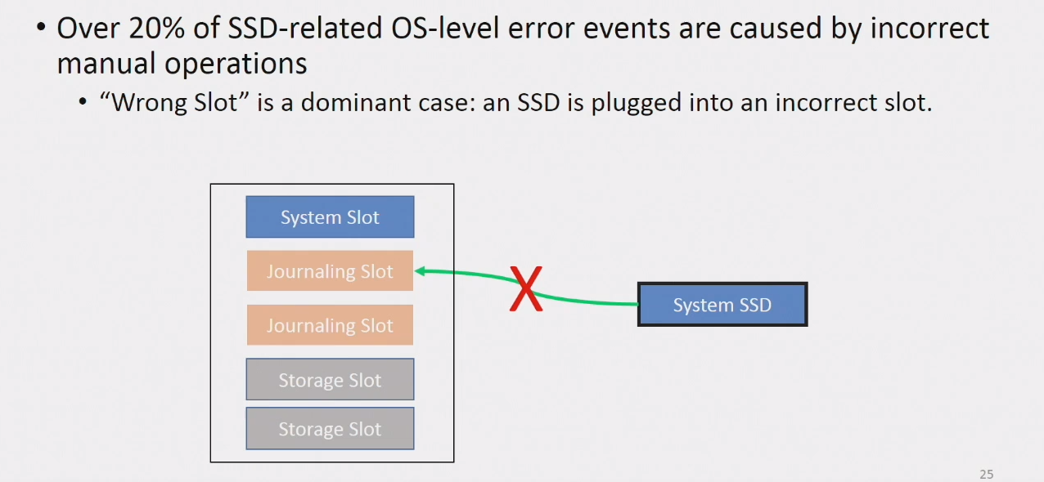
L&A for System Administrator:Part II

Slide 23
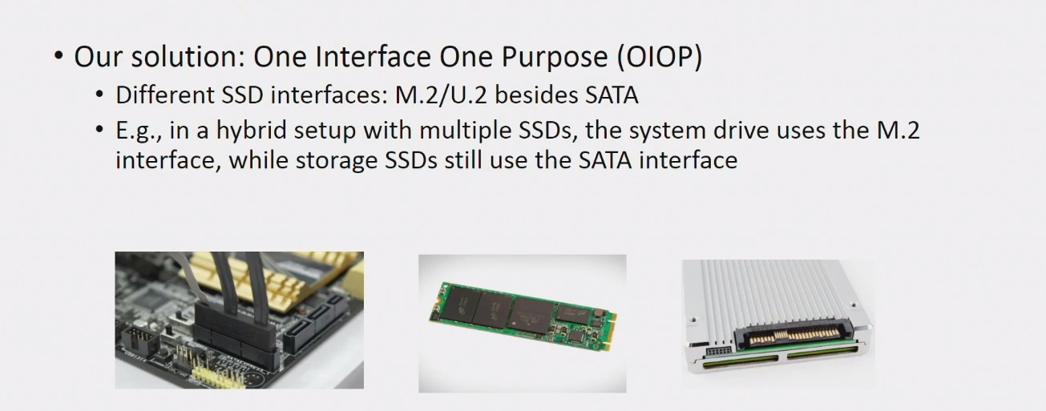
L&A for System Administrator:Part II

Slide 24
总结思考

Slide 25
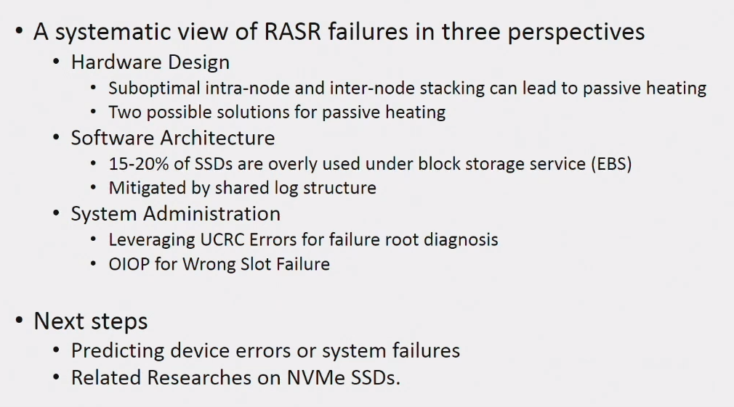
Conclusions

Slide 26
THANKS

